Slide 1
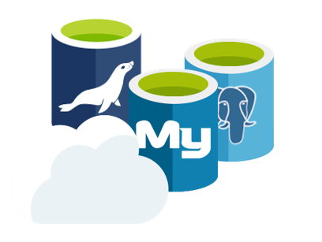
Azure Database Services for MySQL, PostgreSQL and MariaDB

Slide 2













Azure database services for MySQL, PostgreSQL & MariaDB
More choices and full integration into Azure’s ecosystem and services
More choices and full integration into Azure’s ecosystem and services
Managed community database engines
Languages and frameworks of your choice
Scale in seconds with built-in high availability
Unparalleled security and compliance
Industry-leading reach
Managed community MySQL, PostgreSQL, and MariaDB
Languages and frameworks of your choice
Scale in seconds with built-in high availability
Unparalleled security and compliance
Industry-leading global reach
Focus on your apps by leaving the management and patching of your infrastructure and database to an enterprise-ready cloud service.
Build on your terms with a platform that supports your application development needs and offers a fully integrated Azure experience.
Stay up and running without the need for additional replicas and meet the most demanding spikes by elastically scaling performance.
Protect your data with up-to-date security and compliance features with the Azure IP Advantage.
Span more regions worldwide than any other cloud provider.
Easy Lift and Shift
Enterprise Ready
Notes:
Managed community database engines
We are specifically not “forking” the OSS-versions of MySQL, PostgreSQL and MariaDB, but rather picking-up the community editions as they are. This means that customers should have no concerns about application compatibility when moving from either on-premises, IaaS or another cloud to Azure.
Languages and Frameworks of your choice
Being based on the community-editions of MySQL, PostgreSQL and MariaDB mean you can use the existing development languages frameworks and tools you already use for your apps. In addition, Azure Database Services are deeply integrated with Azure Web Apps to provide a streamlined provisioning and management experience for common frameworks (like Wordpress, Drupal, Joomla) and languages (PHP, Node.js, Ruby) to provide a best-in-class PaaS experience.
Scale in Seconds with built-in HA
Azure Database Services are built upon the same service fabric framework that has been powering SQL Database for years. Unlike an VM-based PaaS offering like AWS RDS, Azure Database Services do not have the overhead a full VM stack has (eg; Linux OS + DB). Running on in a secured container implementation (SQLPAL, a very light-weight SQL OS), Azure Database Services can provision a new server in seconds in the event that a primary server hangs or crashes whereas in a traditional VM-based implementation the entire Linux (or Windows) OS stack has to bootstrap before the DB service loads. This means the entire experience of a failover can happen in as little as 30-45 seconds – and most importantly WITHOUT the need for a replica. AWS RDS requires deployment in Multi-AZ in order to achieve 99.95% SLA, which doubles your costs as you have 2 DB servers running at all times. With Azure Database Services, no replicas are needed which means no additional cost, or maintenance, by the customer.
Additionally, this HA infrastructure enables the ability for Azure Database Services to scale performance on the fly. When a customer needs to scale-up for workload spikes, by simply changing a slider in the portal, a new server is provisioned at a higher performance level and the previous server’s DNS name and storage is connected to the new instance. Scaling can take a little time as 20 seconds meaning customers can scale performance, up or down, with little/no downtime to the application.
Secure and Compliant
“Secure by default” is the standard for any Azure service, meaning elements such as SSL encryption between the database and application are turned on by default. Additionally, all data at-rest is encrypted by default in Azure storage using AES 256 bit encryption. And since Azure Database Services are using OSS database engines, the Azure IP Advantage means that customers do not have to worry about litigation using an OSS product in Azure. Microsoft provides indemnification for any OSS first party workload in Azure.
Industry-leading global reach
With more regions across the globe than any other public cloud provider, Azure offers the ability to have the most globally distributed MySQL, PostgreSQL or MariaDB-based application in the world.
Community + Scalability/ HA | vs. VMs
Easy to sell
Easy lift and shift > Enterprise-ready
Easily lift & shift to the cloud, and focus on your apps with enterprise-ready services
Support all your application development needs with a fully integrated experience
Provision in minutes and scale in seconds
Access unparalleled open source indemnification and the most compliance certifications with Azure
Leverage Azure's global reach with more regions worldwide than any other cloud provider

Slide 3
Azure Relational Database Platform
Power BI, App Services, Data Factory, Analytics, ML, Cognitive, Bot…
SQL Data Warehouse
SQL Database
PostgreSQL
MySQL
MariaDB ^{COMING!}
Database
Services
Platform
Intelligent: Advisors, Tuning, Monitoring
Flexible: On-demand scaling, Resource governance
Trusted: HA/DR, Backup/Restore, Security, Audit, Isolation
Azure Compute
Azure Storage
Global Azure with 42 Regions

Slide 4
Service Tiers and Offerings

Slide 5
Service Tiers
Service Tier |  | Basic |  | General Purpose Balanced IO and Compute |  |  |  |  | Performance Optimized Memory Optimized
Intended Use Case |  | Built for workloads with light compute needs and variable IO performance |  | Ideal for most business workloads offering balanced and scalable compute and storage options |  |  |  |  | Cache more data for faster transaction processing and higher concurrency
vCore |  | 1 | 2 | 2 | 4 | 8 | 16 | 32 | 2 | 4 | 8 | 16 | 32
¹Compute Generation |  | Gen 4, Gen 5 |  | Gen 4, Gen 5 |  |  |  |  | Gen 5 only
Storage |  | 5GB – 1TB Magnetic Media |  | 5GB – 2TB Remote SSD |  |  |  |  | 5GB – 2TB Remote SSD
IOPS |  | Variable |  | 100-6000 IOPS |  |  |  |  | 100-6000 IOPS

Slide 6
Service Tiers
Service Tier |  | Basic |  | General Purpose Balanced IO and Compute |  |  |  |  | Performance Optimized Memory Optimized
Intended Use Case |  | Built for workloads with light compute needs and variable IO performance |  | Ideal for most business workloads offering balanced and scalable compute and storage options |  |  |  |  | Cache more data for faster transaction processing and higher concurrency
vCore |  | 1 | 2 | 2 | 4 | 8 | 16 | 32 | 2 | 4 | 8 | 16 | 32
¹Compute Generation |  | Gen 4, Gen 5 |  | Gen 4, Gen 5 |  |  |  |  | Gen 5 only
Storage |  | 5GB – 1TB Magnetic Media |  | 5GB – 2TB Remote SSD |  |  |  |  | 5GB – 2TB Remote SSD
IOPS |  | Variable |  | 100-3000 IOPS |  |  |  |  | 100-6000 IOPS

Slide 7
Service Tiers
Service Tier |  | Basic |  | General Purpose Balanced IO and Compute |  |  |  |  | Performance Optimized Memory Optimized
Intended Use Case |  | Built for workloads with light compute needs and variable IO performance |  | Ideal for most business workloads offering balanced and scalable compute and storage options |  |  |  |  | Cache more data for faster transaction processing and higher concurrency
vCore |  | 1 | 2 | 2 | 4 | 8 | 16 | 32 | 2 | 4 | 8 | 16
¹Compute Generation |  | Gen 4, Gen 5 |  | Gen 4, Gen 5 |  |  |  |  | Gen 5 only
Storage |  | 5GB – 1TB Magnetic Media |  | 5GB – 2TB Remote SSD |  |  |  |  | 5GB – 2TB Remote SSD
IOPS |  | Variable |  | 100-6000 IOPS |  |  |  |  | 100-6000 IOPS
Supported Versions
MySQL: 5.6, 5.7, 8.0 (coming soon)
PostgreSQL: 9.5, 9.6, 10 (coming soon)

Slide 8
Service Features
Security
High Availability
Scale Up/Down on-the-fly
Backup & Restore
Monitoring & Alerting
MySQL Replication
Migration Options

Slide 9

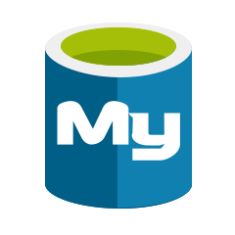
Security built in
Identity
Native authentication
AAD integration
Threat detection
Control access
Secure SSL connectivity
Server firewall rules
Virtual Networks
Protect data
Built-in encryption at-rest for data and backups

Slide 10
VNET Service Endpoint
Extend VNET private address space to Azure Database for MySQL and PostgreSQL
Enabled in CLI and then Portal
Easy to configure (uses Microsoft.SQL service tag)
# Creates the virtual network *myVNet* and subnet *mySubnet*
az network vnet create \
-g myRG \
-n myVNet \
--address-prefixes 10.0.0.0/16 \
-l westus
# Creates the service endpoint
az network vnet subnet create \
-g myRG \
-n mySubnet \
--vnet-name myVNet \
--address-prefix 10.0.1.0/24 \
--service-endpoints Microsoft.SQL
# Create a VNet rule on the sever to secure it to the subnet
az postgres vnet-rule create \
--name myRule \
--resource-group myRG \
--server mypgserver-20180111 \
--subnet mySubnet
Notes:
For Azure Database for MySQL and PostgreSQL, the virtual network rules feature has the following limitations:
At present, an Azure Web App in a subnet that has Service Endpoints turned on does not yet function as expected. We are working on enabling this functionality.
Until this feature is fully implemented, we recommend that you move your Web App to a different subnet that does not have service endpoints turned on for Azure Database for MySQL and PostgreSQL.
In the firewall for your Azure Database for MySQL and PostgreSQL, each virtual network rule references a subnet. All these referenced subnets must be hosted in the same geographic region that hosts the Azure Database for MySQL and PostgreSQL.
Each Azure Database for MySQL and PostgreSQL server can have up to 128 ACL entries for any given virtual network.
Virtual network rules apply only to Azure Resource Manager virtual networks; and not to classic deployment modelnetworks.
Turning ON virtual network service endpoints to Azure Database for MySQL and PostgreSQL also enables the Azure SQL Database services.
On the firewall, IP address ranges do apply to the following networking items, but virtual network rules do not:
Site-to-Site (S2S) virtual private network (VPN)
On-premises via ExpressRoute

Slide 11
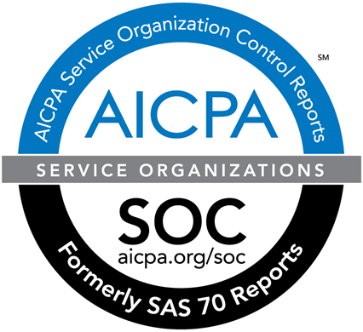




Certifications and Standards
Protect your data with up-to-date security and compliance features with the Azure IP Advantage
SOC2 - Compliant
ISO 27001:2013 - Compliant
ISO 27018:2014 -Compliant
CSA STAR Certification - Compliant
HIPAA / HITECH Act – Compliant
PCI DSS Level 1 – Compliant
ISO 27017:2015 – September 2018
ISO 9001:2015 – September 2018
ISO 22301:2012 – September 2018
ISO/IEC 20000-1:2011 – September 2018
c
SOC 2
Type 2
CSA STAR
Certification
Level 1
Notes:
SOC2 - Service Organization Controls standards for operational security
ISO 27001 - Information Security Management Standards
ISO 27018 - Code of Practice for Protecting Personal Data in the Cloud
CSA STAR - Cloud Security Alliance: Security, Trust & Assurance Registry (STAR)
PCI DSS Level 1 - Payment Card Industry (PCI) Data Security Standard (DSS) Level 1 Service Provider
HIPAA / HITECH Act - Health Insurance Portability and Accountability Act / Health Information Technology for Economic and Clinical Health Act
ISO 27017:2015 - Code of Practice for Information Security Controls
ISO 9001:2015 Quality Management Systems Standards
ISO 22301:2012 Business Continuity Management Standard
ISO/IEC 20000-1:2011 Information Technology Service Management

Slide 12


Built-in High Availability
Elastically scale your compute up or down
Independently scale up storage as needed seamlessly
You don’t need replicas if you don’t need it!
Server provisioning and management
Azure Database Management Service
US West
Application
MySQL IP:3306
PGSQL IP:5432
Gateway
PostgreSQL Client
MySQL or PostgreSQL Server
Retry
MySQL or PostgreSQL Server
Application
MySQL Client
Azure Storage
server=server.mysql.database.azure.com
Notes:
Setting-up high availability for database servers is hard, requiring either custom code to manage detection/failover, or expensive 3rd party solutions to make it a bit easier. Worse yet, it’s expensive as typically a second database server (replica) is necessary in order to fail-over in a matter of seconds. A second server = 2x the cost for HA. For AWS customers, you cannot receive a SLA from Amazon on your database server unless you have deployed in a multi-AZ, again meaning 2x the cost.
Azure Database Services is built upon the SQL Database platform which is a Service Fabric-based PaaS solution. As such, rather than having to boot-up an entire OS stack to bring up a new server (such as in IaaS), Azure Database Services run the database engine in a custom container technology which you can think of as a secure “pico process”. The time it takes to bring-up a new server in this custom container is a matter of seconds. This means that in the event that your database server has hung, or “gone away”, the Azure Database Management Service” detects the failure, brings-up a new server in this lightweight container, maps the new IP address to the DNS name of your instance and maps to your storage. This entire process takes between 30-45 seconds. This is built-in to all performance tiers of Azure Database Services and since a replica instance isn’t needed, there is no additional cost to the custeomers. In contrast, an AWS RDS server that is deployed in a single AZ would take minutes to start – and that does not account for how you would detect the failure and switch-over

Slide 13
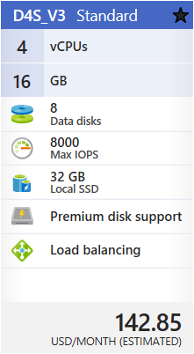
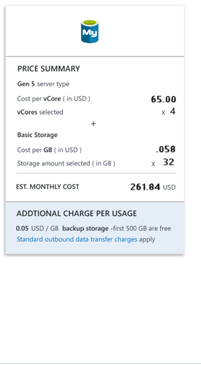
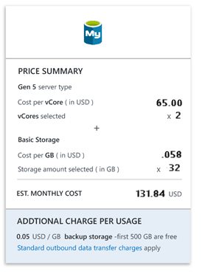
High-Availability & Scale
High-Availability
High-Availability
= $285 vs $132 =
= $285 vs $262 =
Notes:
Customers who are IaaS customers in Azure today to understand that the specs of a VM do not equate directly to the specs of Azure Database Services. The reason is two-fold:
Customers do not size a VM based on their typical workload, rather they size wisely to handle workload spikes so as not to impact performance of the application. With Azure Database Services, the ability to scale performance on the fly means they SHOULD size their instance based on typical workload needs and then elastically scale when necessary. This lowers costs.
A VM has to support the performance requirements for both the database engine as well as the host OS. With Azure Database Services, the SQLPAL isolated pico-process (mini-OS) significantly lowers the HW needs compared to a VM.
So in this example, if I have a D4S_V3 VM with 4 vCPUs and 32GB of SSD, when I choose an Azure Database for MySQL the customer can likely choose a smaller size of 2 vCores with the same storage (and in fact, they would get more storage as the storage for Azure Database Services is dedicated to the database, logs, etc – no host OS footprint here). The customer can then profile their workload and determine if it meets their performance requirements, and if it does not, they can easily scale-up to the next tier.
More importantly, in an IaaS VM implementation, if you want to achieve HA you need a second server (replica). This will double their costs, in this case from $143/mo to $286/mo. With Azure Database Services with built-in HA, there are no additional replicas needed and as such – there is no cost impact. So to sum up this example, a HA IaaS MySQL VM costs $286/mo, whereas Azure Database for MySQL would cost $132/mo. That’s a saving of $154/mo.

Slide 14
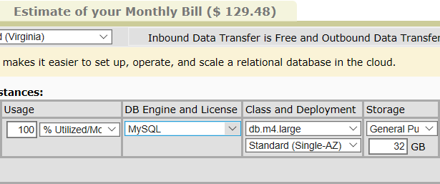
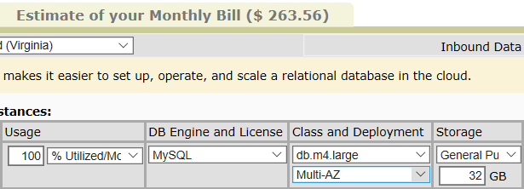
High Availability in AWS RDS vs. ADS
High-Availability
AWS RDS with a 99.95% SLA is 2x more expensive* than Azure Database for MySQL/PostgreSQL
High-Availability
* as of April 2018
Notes:
We have made an implicit decision to price-match AWS RDS in order to be competitive in the market. This means that the price disparity between AWS RDS vs. Azure Database Services is minimal, if at all. In this case, an AWS RDS db.m4.large MySQL instance (2vCPU) with 32GB of SSD would match Azure Database Services (spec-wise) at a 2 vCore General Purpose SKU.
However, like the IaaS VM scenario, there is a big difference between AWS RDS and Azure Database Services. AWS RDS only offers a 99.95% uptime SLA if the database servers is deployed in a Multi-Availability Zone. If they deploy in a single-AZ, there is NO SLA from AWS. With Azure Database Services, we provide a 99.99% SLA on all instances without the need to have additional replicas. So in this case, AWS would cost you $264/mo whereas Azure Database for MySQL would cost only $132/mo. A $132/mo savings!

Slide 15
Scale Performance on the Fly
Scale your server compute up or down in seconds!
Independently scale up storage as needed
Server provisioning and management
Azure Database Management Service
US West
MySQL IP:3306
PGSQL IP:5432
Application
Gateway
PostgreSQL Client
MySQL or PostgreSQL Server
MySQL or PostgreSQL Server
Application
MySQL Client
Azure Storage
server=server.mysql.database.azure.com
Notes:
Leveraging the same technology that powers our High-Availability, Azure Database Services provides the ability to scale performance on the fly with little/no application downtime. Scaling is as simple as literally changing a slider to increase or decrease vCores, and clicking OK. Scaling effectively brings-up a new server at the new performance tier, and switches over to the storage on the previous server and maps to the existing DNS name, all in about 15-20 seconds. This means that customers do not have to worry so much about the size of the server they need coming into Azure. They can choose a SKU to start and then monitor the performance of their database server to determine if they should either scale-up or scale-down their server based on their workload. Customers can then set alerts on metrics such as CPU or Memory usage to notify them in the event they need to scale-up their server for workload spikes.

Slide 16
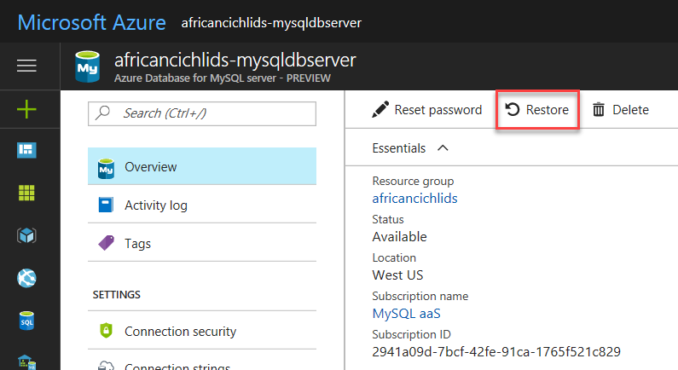
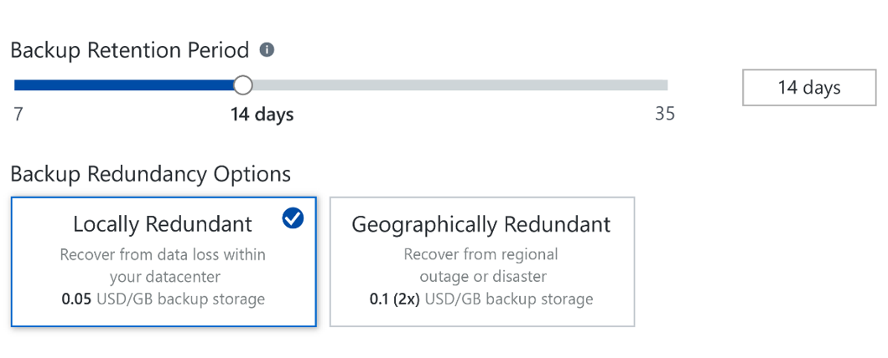
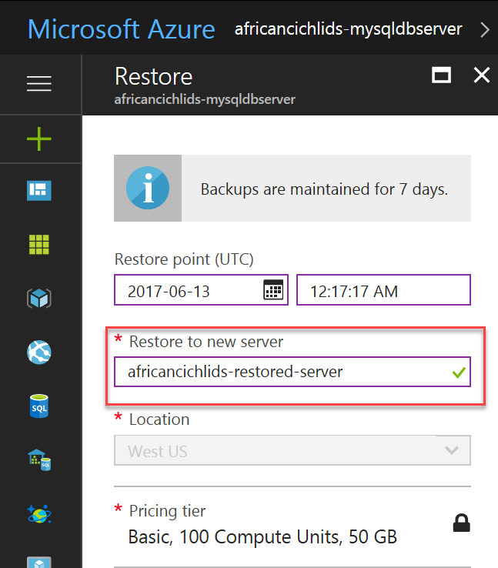
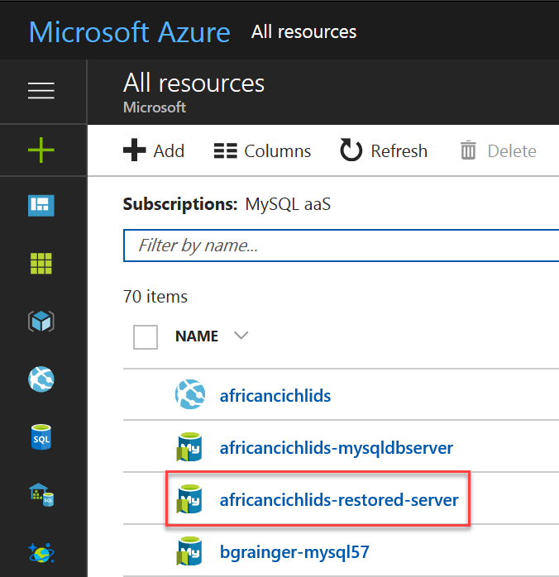
Backup & Restore
Built-in backups
Choose LRS or GRS
Restore from geo-redundant backups for disaster recovery (RPO <= 1 hr)
1x Backup storage included
PITR up to 35 days (minimum 7 days)

Slide 17
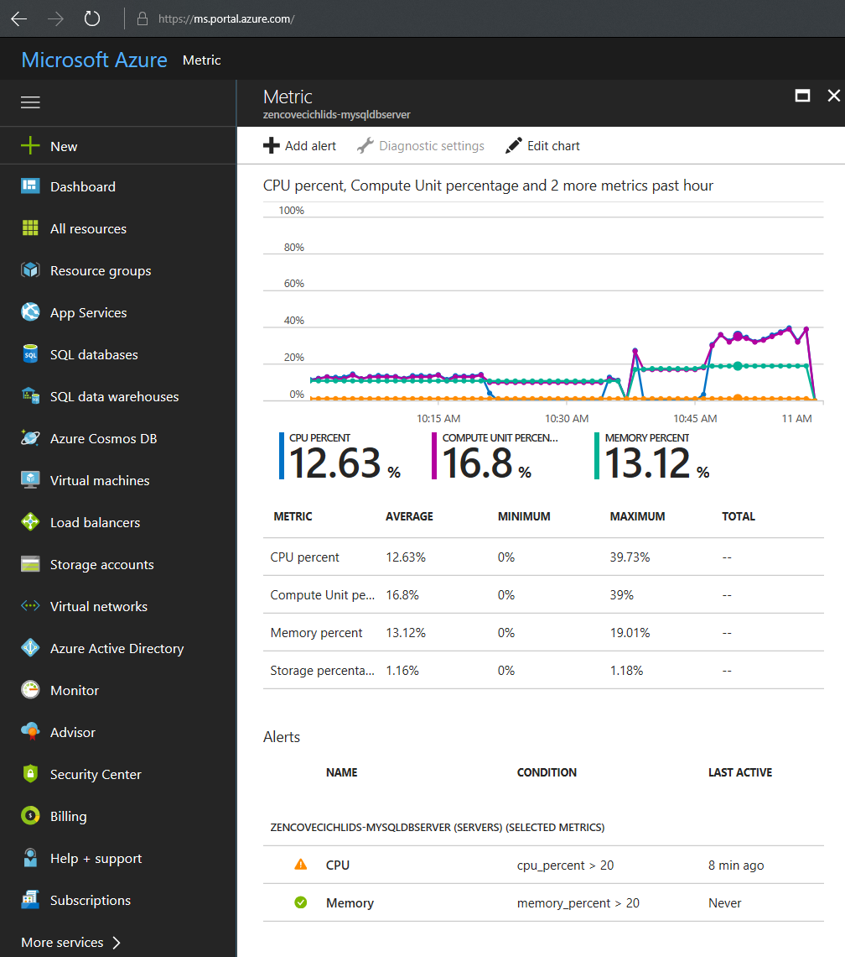
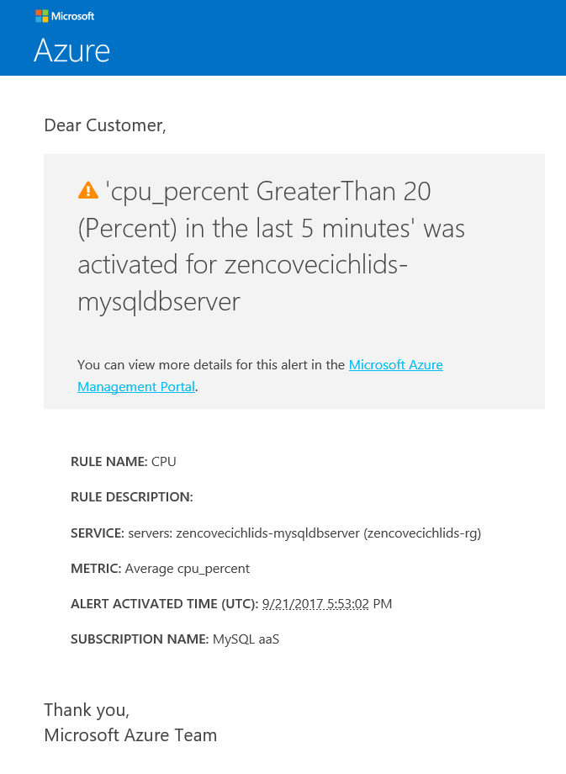
Monitoring & Alerting
Built-in monitoring
Configurable alerts
Auto Notifications
Enabled for database engine monitoring by default

Slide 18



Replication (MySQL)
Data-in Replication (for migration scenarios)
Replica in Azure, master in VM, on-premises server or other cloud provider (with binlog replication)
For hybrid, multi-cloud synchronization or migration
Same region replica (for read scale-out)
Up to 5 replicas - both master and replica in the same Azure region
Master
Replica
Replica 1
Replica 2
Replica 3
Replica 4
BI
Read
Write
Read
Native MySQL Replication
Notes:
MySQL Read Replicas are used by customers to achieve read scale-out, which helps mitigate performance impact on the primary server for workloads that are extremely read-heavy.
For Azure Database Services, we are introducing Read Replicas for MySQL in Preview at the end of March. We are using native engine replication which uses replication of the binlog to keep the replicas up to date with the Master server. We provide 2 replication scenarios for Azure Database Services for MySQL:
Data-In Replication: This is the ability to set-up a replica server in Azure linked to a master server in another location. This could be an Azure IaaS MySQL VM, on-premises MySQL server or a MySQL server in another public cloud. This is primarily targeted at enabling customers to migrate their MySQL server from another location/service into Azure Database for MySQL. By using replication for this migration scenario, there is little/no downtime for the customer’s application. Once the replica is seeded from the master, it is then kept asynchronously up to date, meaning the customer can move their application over by simply changing their connection string.
Same-Region Replica: This is standard MySQL read replication enabling customers to set up to 5 read-replicas in the same Azure Region as their Master server. This is limited to 5 replicas to minimize performance impact on the Master, as each replica server has some performance impact on the Master server, which is typically between 10-15%. (Note that AWS also only supports up to 5 replicas in RDS today)
Over the next 6 months we will be bringing PostgreSQL native engine replication to Azure Database Services as well. In addition, at this time we will be introducing the ability to setup your replica servers in Azure regions outside of the Region your Master server is located, enabling world-wide read scale-out.

Slide 19
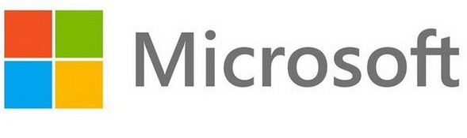
Migration Methods
MySQL dump and PG dump
Native commands, no additional
Migration wizard
Native or 3rd party tools
Replication
Attunity, near-zero down time migration
4. Azure Database Migration Service
Native way, no additional setup
Use when application can tolerate downtime
Third party solution, needs setup
Use when application cannot tolerate downtime
Fully-orchestrated migration service
Notes:
Here are other migration options in addition to Data-In replication for MySQL as we just talked about.
Of course customers can use the familiar tools that exist today for dumping your database and importing into Azure, but of course this implies downtime for your application as once your dump your database, changes cannot be made to the original server until you import your data into the new server in Azure. This isn’t acceptable for most workloads – but is an option.
Attunity Replicate for Microsoft Migrations is a free-offering from Microsoft and Attunity that helps orchestrate the migration of data only from sources outside of Azure into Azure Database Services. This is similar to Data-In replication for MySQL, but provides a simple interface to set-up that is literally a “click and drag” migration operation. Additionally, this is extremely useful for PostgreSQL customers as there is currently not a Data-In migration solution for them today. However there are a few limitations, primarily that sources from other public clouds such as AWS or GCP are not supported.
Later this year, before the 2nd have specifically, we’re excited to bring forth the Public Preview of the Azure Database Migration service for MySQL and PostgreSQL. Unlike the Attunity solution above, DMS will provide additional source options such as AWS RDS.

Slide 20
Key learnings for achieving best performance
Network latency
Measure with SELECT 1 tests from the client using mysql shell
Average should be < 2msec
Best practice:
Ensure application and database server is in the same region, created within same resource group
Configure VM (hosting the application) with accelerated networking

Slide 21
Key learnings for achieving best performance
Storage
Monitor “IO Percent” and “Storage Percent” using Azure portal or Azure CLI
Use mysql (performance_schema) or postgres (pg_stat_statements) to determine queries taking longer time
Best practice:
Evaluate/tune indexes and queries as necessary.
Ensure adequate IOPS is provisioned for the instance.
IOPS scale at approximately 3 IOPS per GB.
Rule of thumb is to not exceed 80% of available IOPS (IO Percent) on average.
Configure alerts on “IO Percent” and “Storage Percent” as necessary using Azure portal or CLI
Consider Memory Optimized tier

Slide 22
Key learnings for achieving best performance
CPU
Monitor “CPU percent” using Azure portal or Azure CLI.
Use mysql (performance_schema) or postgres (pg_stat_statements) to determine queries taking longer time
High CPU usage is not the only indicator of CPU bottleneck. Do you have single threaded app?
Best practice:
Strongly recommend using General Purpose
Validate/tune indexes and queries as necessary
Ensure server log parameters are tuned for production workload
Tune database connections from the application. Use connection pooling or front end or application caching (if suitable). Consider Memory Optimized.
Configure alerts on “CPU percent” as necessary using Azure portal or CLI

Slide 23



Quick COMPARISON
 | AWS RDS | AWS Aurora | Google Cloud SQL | Azure Database Services
OSS DB engines | MySQL, MariaDB, PostgreSQL | Proprietary MySQL and PostgreSQL with app compatibility | MySQL, PostgreSQL (beta) | MySQL, PostgreSQL, MariaDB
Compute/RAM | M4-instance - 60 VCPU, 256 GB RAM R4 instance - 64 VCPU, 488 GB RAM | R4 instance – 64 VCPU, 488 GB RAM | Standard - 64 VCPU, 240GB RAM High mem – 64 vCPU, 416 GB RAM | GP - 64 vCores, 320 GB RAM (Gen 4) MO- 32 Cores, 320 GB RAM (Gen 5)
Storage scale/IOPS | GP SSD: 20 GB – 16 TB (100-10000 IOPS) Provisioned IOPS: 100 GB – 16 TB (1000-40000 IOPS) | 10GB -> 64 TB *Automatic storage increase in 10 GB chunks | 10GB->10 TB (40,000 IOPS) *Automatic storage increase | Basic: 5 GB -> 2 TB GP/MO -> 5 GB- 1TB (100-6000 IOPS)
Availability SLA | 99.95% for multi-AZ only | 99.95% for multi-AZ only | 99.95% | 99.99% SLA for all databases
Multi-AZ deployment (synchronous standby)* | Yes | Yes | Yes | In-region replica when required to meet SLA Multi-AZ (future)
On-Line Compute Scaling | No | No | No | Yes
Backup Retention | 1-35 days | 1-35 days | 7 days | 7-35 days
Encryption at Rest | Yes (opt-in) | Yes (opt-in) | Yes (default) | Yes (default)
Read Scale* | Up to 5 readable replicas | Up to 15 readable replicas | Yes | Up to 5 replicas for MySQL (in preview) PostgreSQL in roadmap
Ability to Promote Read Replica to Primary | Yes | Yes | Yes | Yes
* as of Jan 2018

Slide 24
Roadmap

Slide 25
Service availability - Regions

Available

Coming Soon

No Plan
AMERICAS (10/11) | US |  |  |  |  |  |  |  | LATAM | CANADA
 | Central US | East US | East US 2 | North Central US | South Central US | West Central US | West US | West US 2 | Brazil South | Canada Central | Canada East
GEN4 (9 regions out of 11) |  |  |  |  |  |  |  |  |  |  | 
GEN5 (10 regions out of 11) |  |  |  |  |  |  (CY19 Q2) |  |  |  |  | 
AMERICAS GOV (0/6) | US GOV |  |  |  | US DOD
 | US Gov Arizona | US Gov Iowa | US Gov Texas | US Gov Virginia | US DoD Central | US DoD East
GEN4 (0 regions out of 6) |  |  |  |  |  (6/30) |  (6/30)
GEN5 (0 regions out of 6) |  (9/30) |  (9/30) |  (6/30) |  (9/30) |  (CY19 Q2) |  (CY19 Q2)
EUROPE (4/8) | EUROPE |  |  |  | UNITED KINGDOM |  | AZURE GERMANY
 | North Europe | West Europe | France South | France Central | UK South | UK West | Germany Central | Germany NE
GEN4 (2 regions out of 8) |  |  |  |  |  |  |  | 
GEN5 (4 regions out of 8) |  |  |  (TBD) |  (6/30) |  |  |  (6/30) |  (9/30)
ASIA PACIFIC (10/15) | SE ASIA |  | AUSTRALIA |  |  |  | INDIA |  |  | JAPAN |  | KOREA |  | AZURE CHINA
 | East Asia | SE Asia | Australia East | Australia Central | Australia Central2 | Australia SE | Central India | South India | West India | Japan East | Japan West | Korea Central | Korea South | China East | China North
GEN4 (6 regions out of 15) |  |  |  |  |  |  |  |  |  |  |  |  |  |  (6/30) |  (6/30)
GEN5 (10 regions out of 15) |  |  |  |  (7/30) |  (TBD) |  |  |  |  |  |  |  (6/30) |  |  (6/30) |  (6/30)
* Data as of May 21st, 2018
Notes:
Refer to: https://azure.microsoft.com/en-us/regions/services/

Slide 26
What’s new since GA
GA of Geo Restore (https://docs.microsoft.com/en-us/azure/mysql/howto-restore-server-cli)
GA of Storage scale to 2TB and 6000 IOPS (https://docs.microsoft.com/en-us/azure/mysql/concepts-pricing-tiers)
GDPR Compliance
Public Preview of VNET service endpoint (https://docs.microsoft.com/en-us/azure/mysql/concepts-data-access-and-security-vnet)
Public Preview of MySQL data-in replication (https://docs.microsoft.com/en-us/azure/mysql/concepts-data-in-replication)
Private Preview of MySQL & PostgreSQL source in Azure Database Migration Service (https://aka.ms/dmspreviewpage)
Scaling across SKUs (General Purpose and Memory Optimized)
Scaling across hardware generation (Gen 4 and Gen 5)
Private Preview of Query Store
Private Preview of MySQL same region replica
New regions
Asia Pacific: Australia South East (Gen5) & South India (Gen5)
Regions with additional hardware generation
Americas: Brazil South (Gen5), Central US (Gen4) & East US 2 (Gen5), North Central US (Gen5), South Central US (Gen5)
Asia Pacific: East Asia(Gen5), India Central (Gen5), India West (Ge5), Japan East (Gen5), Japan West (Gen5) & South East Asia (Gen5)

Slide 27
What’s COMING NEXT..
Private Preview of PostgreSQL read replicas within a region
Azure AD Integration
Threat Detection
64 vCores support for General Purpose
Increase storage scaling to 4 TB and 12000 IOPS
Increase storage scaling to 10 TB and 30000 IOPS
New Regions
Australia Central (Gen5)
China East (Gen4 & Gen5)
China North (Gen4 & Gen5)
Germany Central (Gen5)
Korea Central (Gen5)
US DoD Central (Gen4)
US DoD East (Gen4)
US Gov Texas(Ge5)

Slide 28


WordPress news site cuts costs 45% by moving to azure database for MySQL
Challenge
Growing popularity of the news company’s WordPress site lead to performance and scalability issues.
Solution
Moving the WordPress site to Azure Database for MySQL enables:
low page load times,
on-demand scalability
A 45 percent reduction in costs.
“The biggest benefit of Azure Database for MySQL will be to have Microsoft manage and back up that resource for us so that we can focus on other aspects of the site.”
Kevin Lisota
Web Developer
Notes:
http://customers.microsoft.com/en-us/story/geekwire

Slide 29
Demos
Flexibility
Do exactly what you want with the community edition hosted on a VM. | Overview: Azure Database for PostgreSQL and MySQL – (11 mins)
Scale up to add more customers with ease. | Deep dive on managed service capabilities for MySQL and PostgreSQL – (16 mins) Build scalable web applications with Azure Database for MySQL – (6 mins)
Scale out to reduce latency and increase response time to your customers.
Maintain high availability with an SLA of 99.99%.
Connect easily with other app services and web apps to create your app. | Develop an intelligent analytics app with PostgreSQL – (12 mins)
Choose from 5 SKUs and easily move across them. | Overview: Azure Database for PostgreSQL and MySQL – (11 mins)
Remove the need to patch with a choice of editions and a fully managed service with back up and restore (PITR 35 days) | Deep dive on managed service capabilities for MySQL and PostgreSQL – (16 mins)
Intelligence
Make your app intelligent with cognitive services, machine learning and PowerBI | Develop an intelligent analytics app with PostgreSQL – (12 mins)
Security
Rest easy with layers of security through robust firewalls and SSL | Deep dive on managed service capabilities for MySQL and PostgreSQL – (16 mins)

Slide 30
Resources
Azure service page:
PostgreSQL: http://aka.ms/postgresql
MySQL: http://aka.ms/mysql
Documentation:
PostgreSQL: Azure Database for PostgreSQL
MySQL: Azure Database for MySQL
Discussion forum:
PostgreSQL: MSDN, StackOverflow
MySQL: MSDN, StackOverflow
Feedback forum:
PostgreSQL User Voice
MySQL: User Voice
Hands on Lab:
PostgreSQL: http://aka.ms/postgresqlhol
MySQL: http://aka.ms/mysqlhol
GitHub repo:
https://github.com/Azure/azure-postgresql
Twitter: @AzureDBPostgres, @AzureDBMySQL

